Slide 1
WORLD POPULATION ANALYSIS
RAGAVENDRA

Slide 2
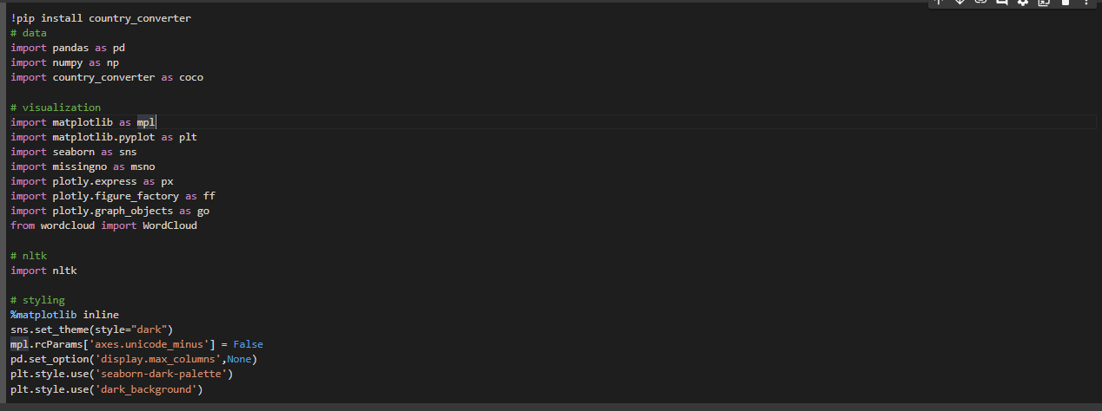
IMPORT REQUIRED LIBRARIES

Slide 3
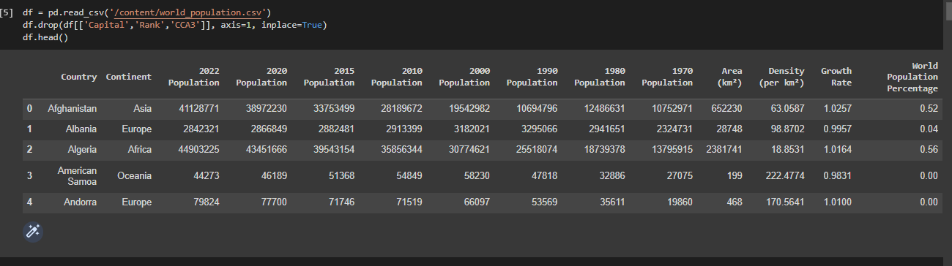
READ THE DATASET

Slide 4
Univariate Analysis
In this section, we'll explore each columns in the dataset to see the distributions of features, and to get some useful informations. Mainly two parts in the section: Analysis on categorical columns; Analysis on numeric columns.

Slide 5
2.1. Categorical Columns AND CONTINENTS
Only 2 categorical column in the dataset:
Continent, Country
There's 6 categorical values in column 'Continent' each are:
Africa
Asia
Europe
North America
Oceania
South America

Slide 6
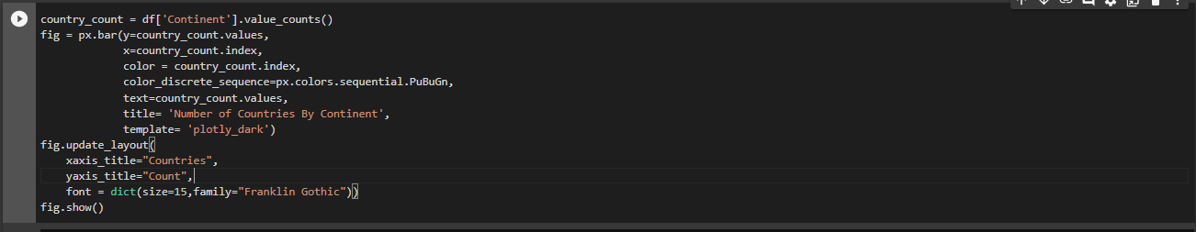
Africa, Asia and Europe ranked top 3 frequent continents, but it can be easily seen that others are also related to those top 3 continents.
We'll analyse the population of each country and continent for decades.Countries and continents by plotting map & bar charts in this section.

Slide 7
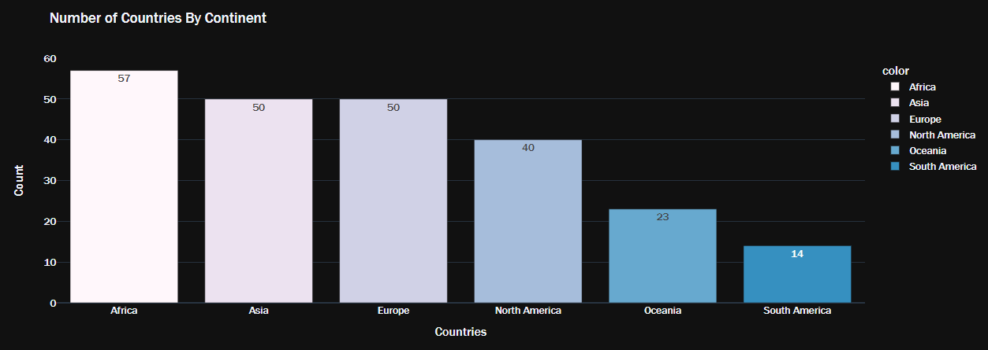
NUMBER OF COUNTRIES BY CONTINENT

Slide 8
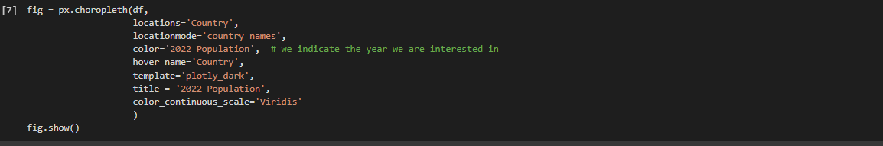
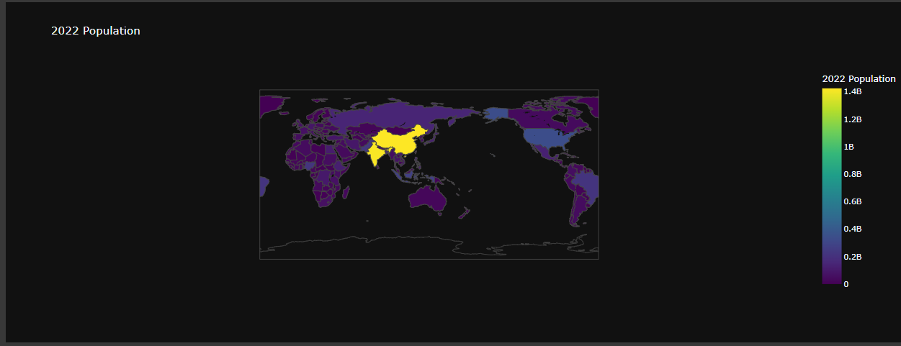

Slide 9
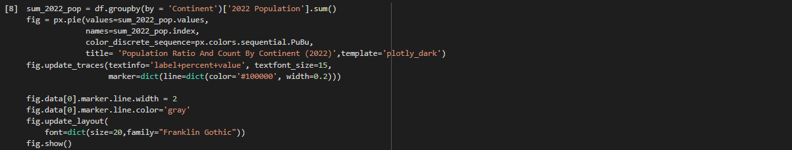
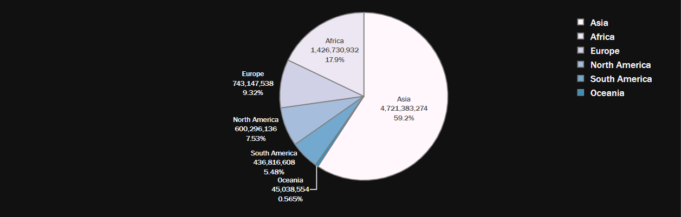
POPULATION RATIO AND COUNT BY CONTINENT

Slide 10
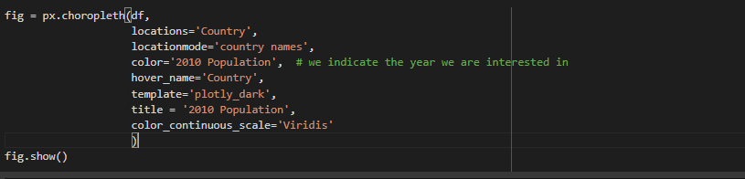
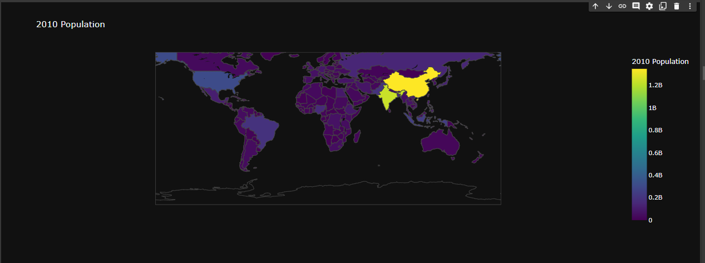
As can be seen in the graphic, the Asian continent alone constitutes more than 55 percent of the world's population in 2022. .AND CHECKOUT THE 2010 POPULATION BELOW

Slide 11
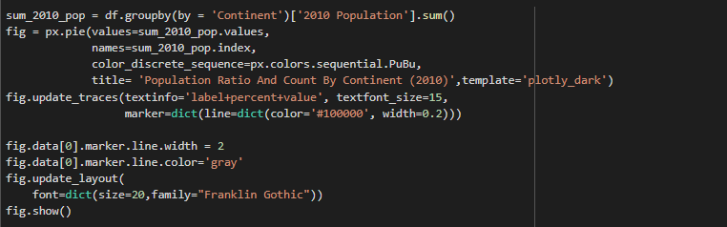

Population Ratio And Count By Continent (2010)

Slide 12
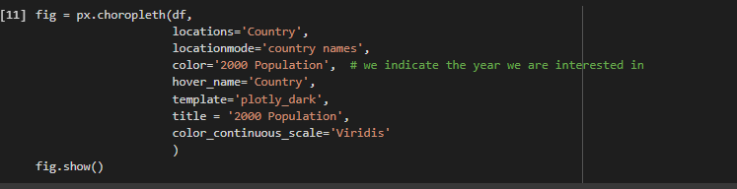
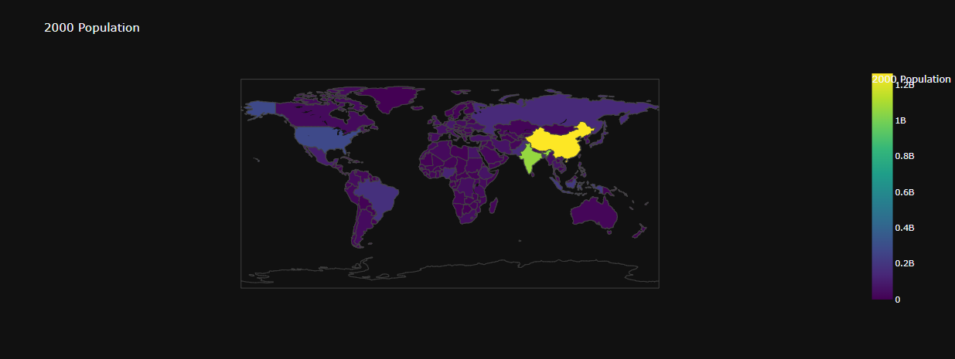
2000 population

Slide 13
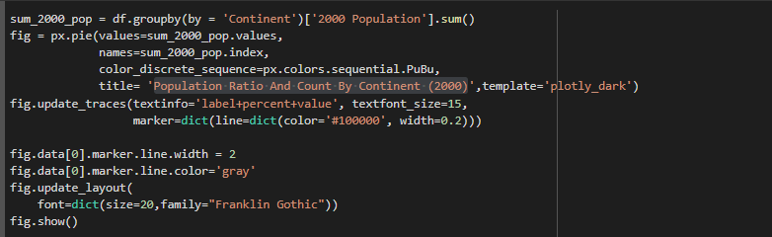
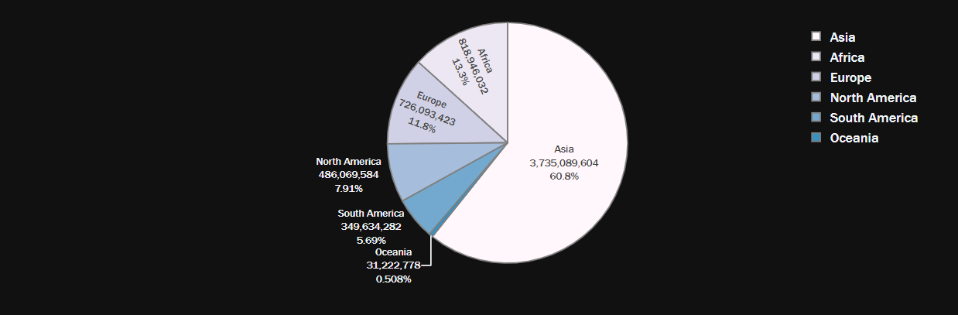
Population Ratio And Count By Continent (2000)

Slide 14
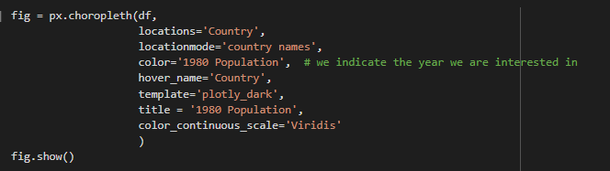
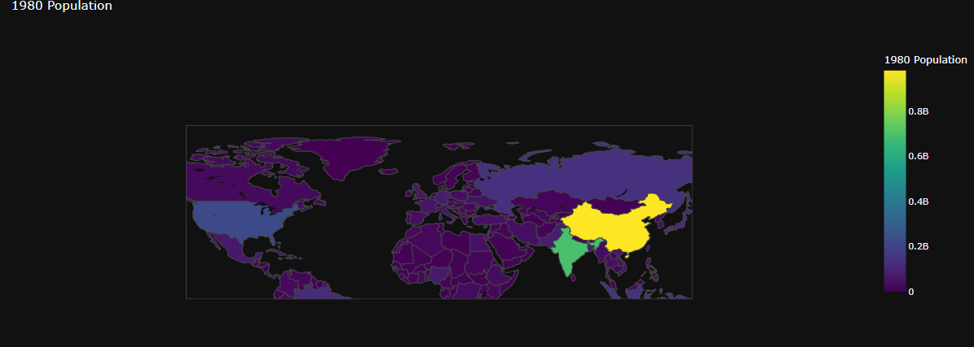
1980 POPULATION

Slide 15
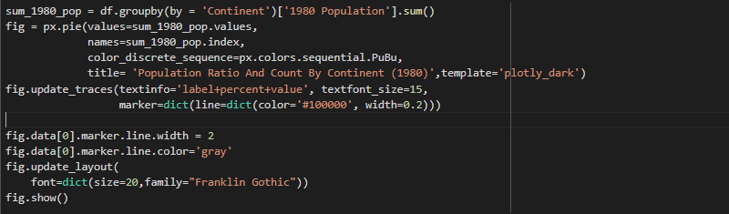
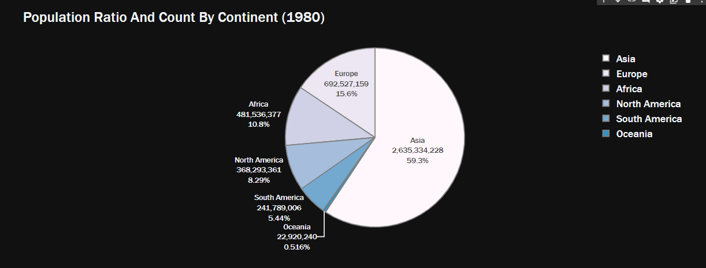
Population Ratio And Count By Continent (1980)

Slide 16
Insights About Continent Variable
Although the population has increased over the past 10 years, there has not been a great change in the continents in percentage.
Asia, Africa and Europe alone constitute more than 80 percent of the world's population.

Slide 17
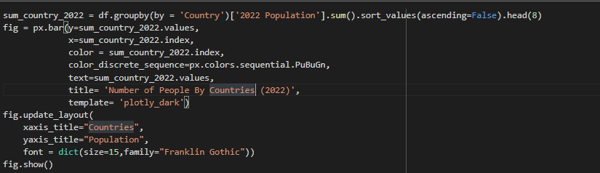
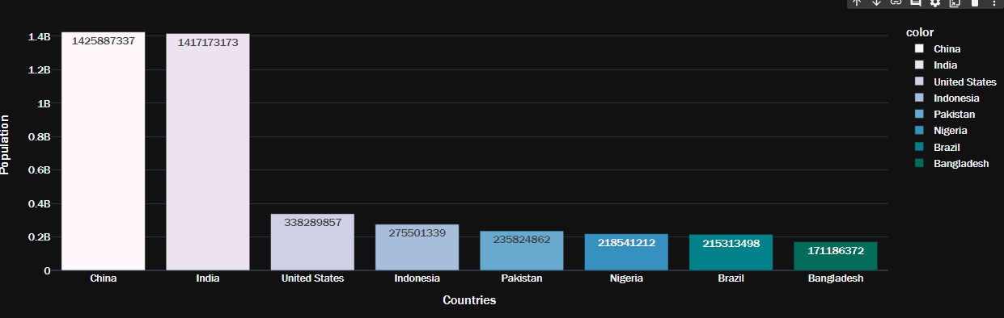
Number of People By Countries (2022)

Slide 18
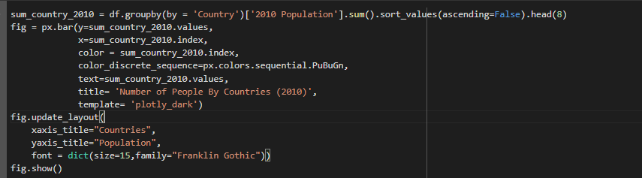
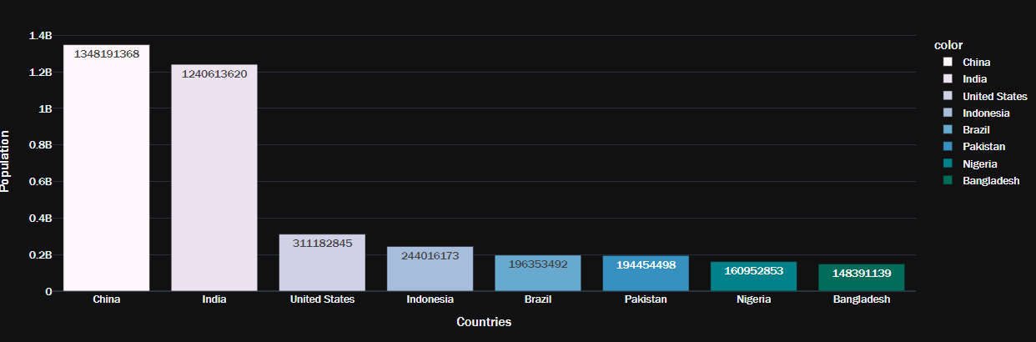
Number of People By Countries (2010)

Slide 19
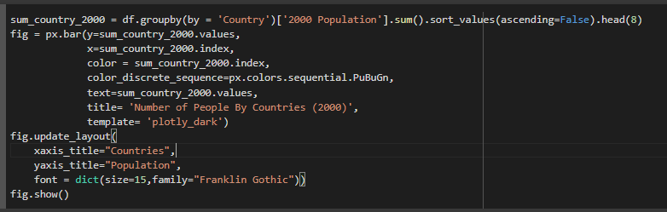
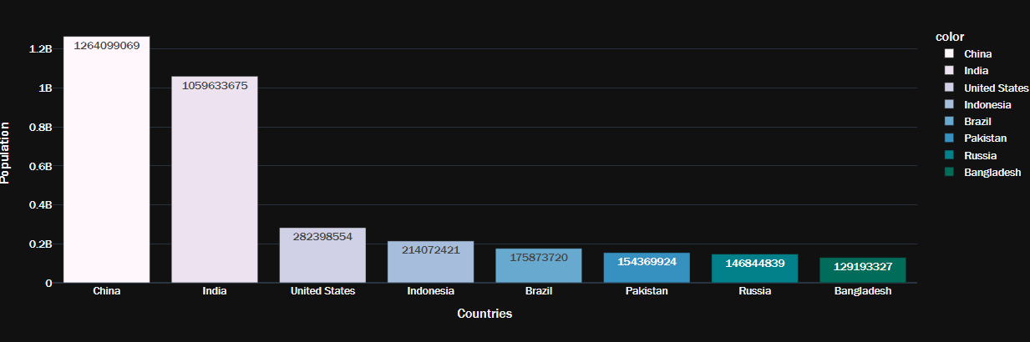
Number of People By Countries (2000)

Slide 20
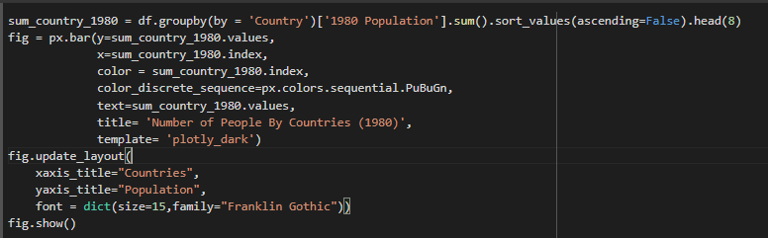
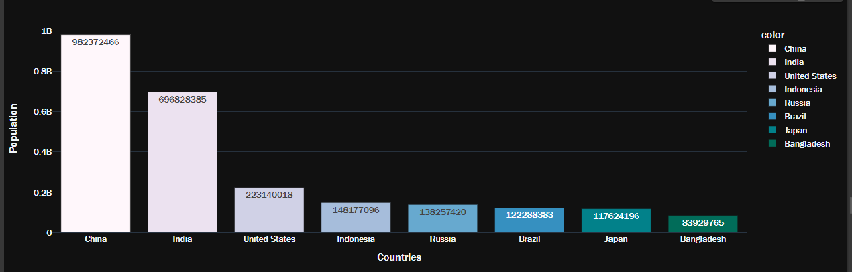
Number of People By Countries (1980)

Slide 21
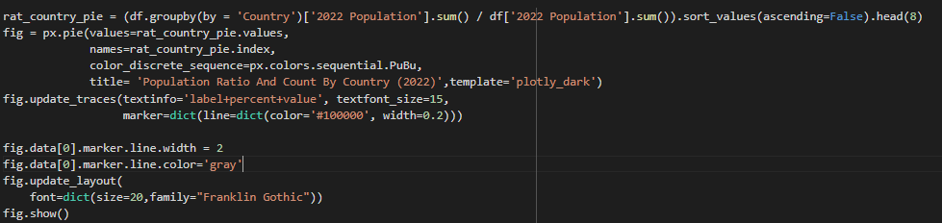
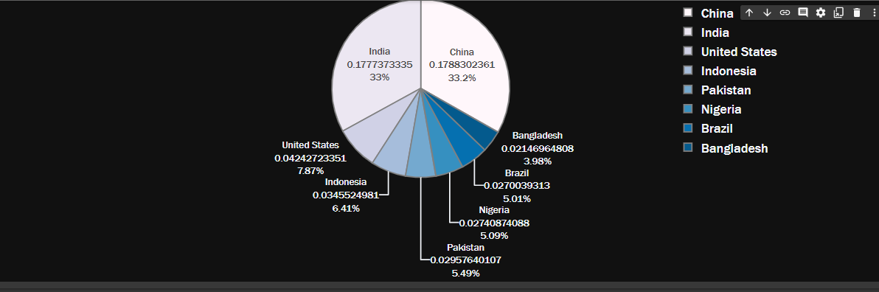
Population Ratio And Count By Country (2022)

Slide 22
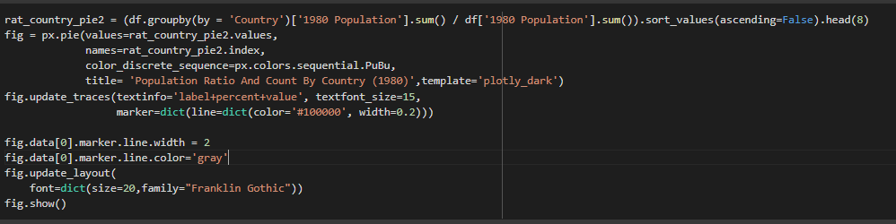
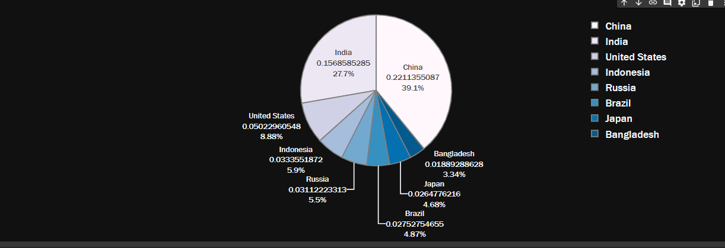
Population Ratio And Count By Country (1980)

Slide 23
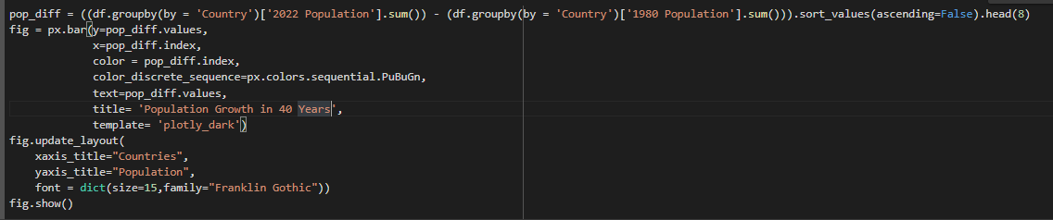
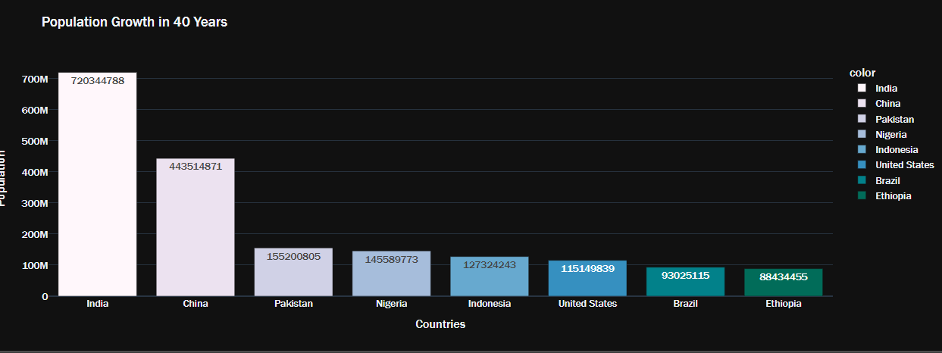
POPULATION GROWTH in 40 years

Slide 24
INSIGHTS ABOUT COUNTRY VARIABLE
In 2022 and in 1980 India and China alone constitute more than 65 percent of the world's population.
India,China ad Pakistan most growth countries in 40 year.

Slide 25
2.2 NUMERICAL COLUMNS
Only 2 numerical column in the dataset we are going to review:
Area
Density Per KM

Slide 26
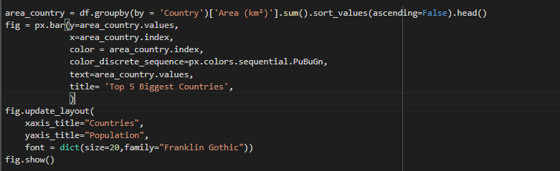
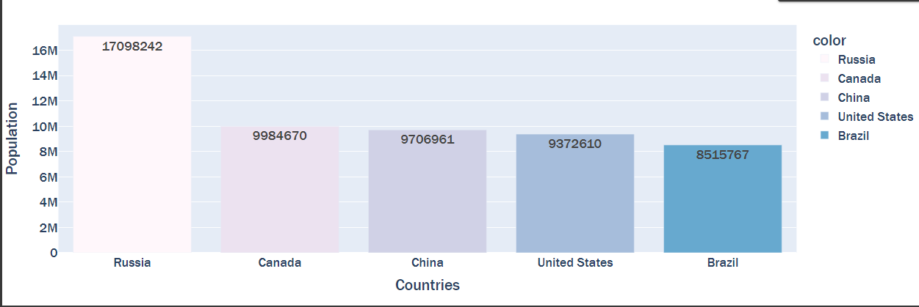
Top 5 Biggest Countries

Slide 27
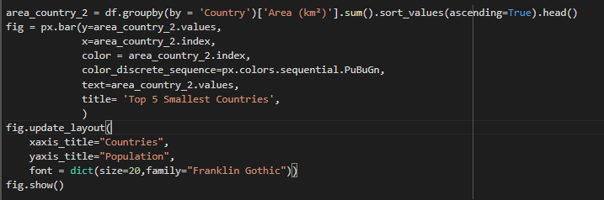
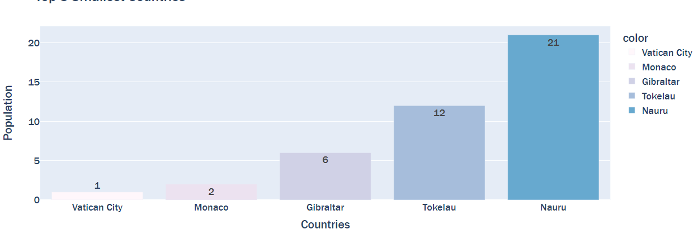
Top 5 Smallest Countries

Slide 28
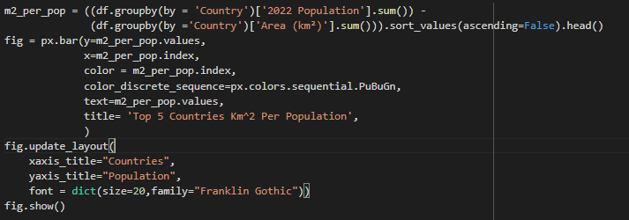
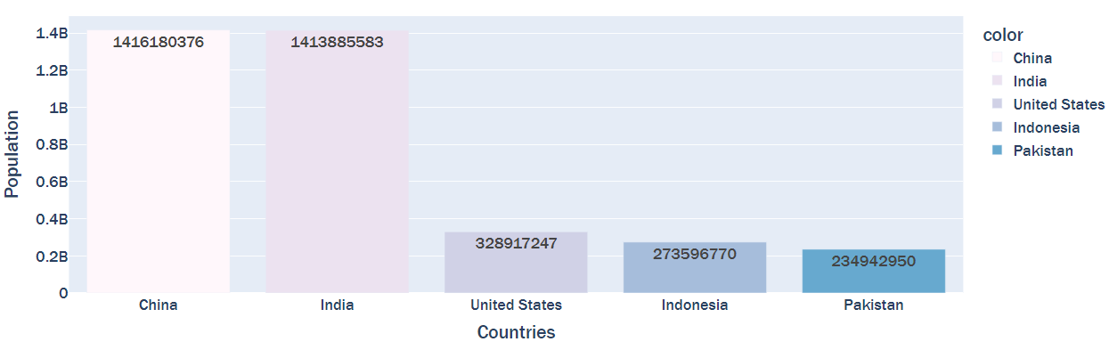
Top 5 Countries Km^2 Per Population

Slide 29
CONCLUSION
As we see Russia by far biggest country in the world.
If we look at the side of data density per population China and India too much crowded than the other countries.

Slide 30
THANK YOU

